Slide 1
CSS
MCNDHS
Ms. Eng

Slide 2
aim: css-boxes-opacity and border radius
Do now:
Daily Grade:
On-time/attendance/not leaving the classroom: 25%
Cellphones: 25%
Notes:25%
Classwork/Homework: 25%

Slide 4

where you see it:

Slide 5
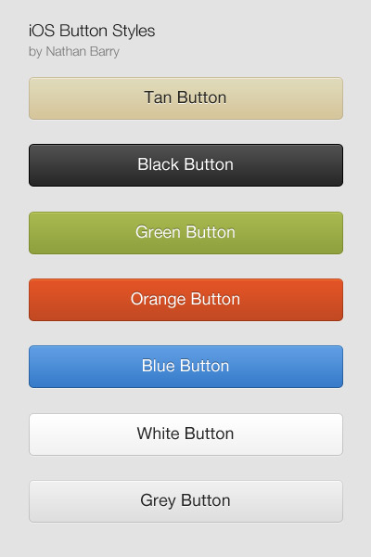
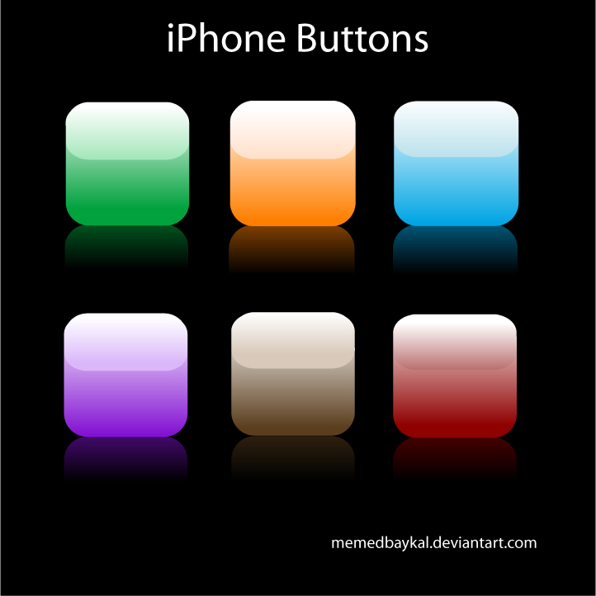
where you also see it

Slide 6
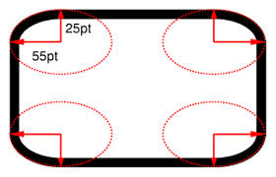
description

Slide 7

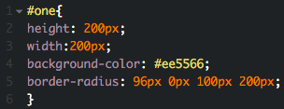

example code:

Slide 8

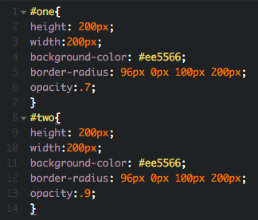
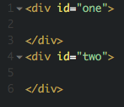
opacity:
0.0 - .5 Light
.5 - 1.0 Dark

Slide 9


activity

